Slide 1
MATLAB for Scientists Lecture 2

Slide 2
Introduction to vectors and matrices
Matrix manipulation
Simple data I/O

Slide 3
Scripts recap
Useful for writing algorithms and performing analyses that can be stored
They can be run from the command line, from the ’run’ arrow, and by calling other scripts
They can never have spaces in the name or else they won’t run
Must be located in your current directory

Slide 4
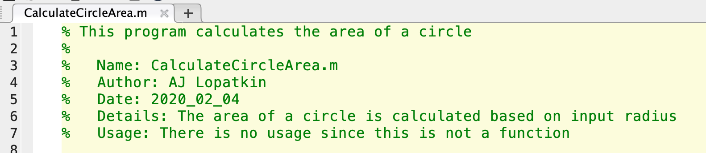
Proper script headers
Every script should contain the following in comments at the top:
% Description
% Empty line
% Name: script name
% Author: STUDENT ID
% Date: Date written
% Details: Specific details of what the script does
% Usage: only filled in if a function

Slide 5
Datasets can be represented by matrices
Predator | 200 | 192 | 170 | 133 | ..... | 340
Prey | 10 | 56 | 95 | 152 | ..... | 29
Time | 0 | 10 | 20 | 30 | ..... | 200

Slide 6
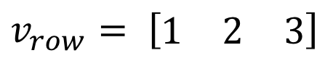
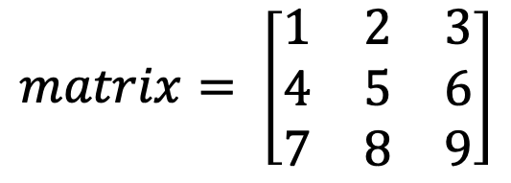
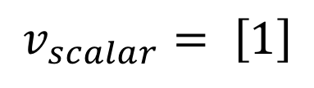
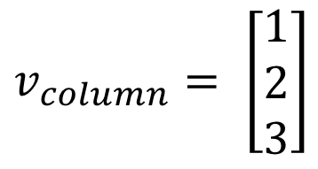
Vectors and matrices are used to store sets of values
A vector can be either a row vector or a column vector.
Vectors with 1 element are called scalars
A vector with more than 1 row and column is a matrix
$$v_{column}= \left[\begin{matrix}1 \\ 2 \\ 3\end{matrix}\right]$$
$$v_{row}= \left[\begin{matrix}1 & 2 & 3\end{matrix}\right]$$
All the values stored in these matrices are called elements
$$v_{scalar}= \left[1\right]$$
$$matrix= \left[\begin{matrix}1 & 2 & 3 \\ 4 & 5 & 6 \\ 7 & 8 & 9\end{matrix}\right]$$

Slide 7
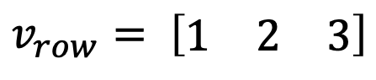
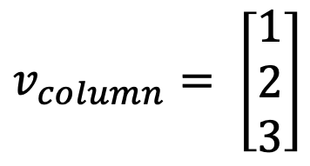
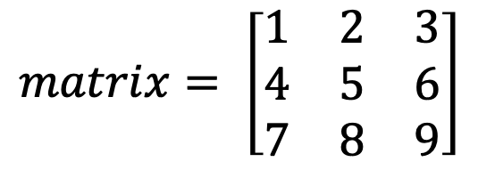
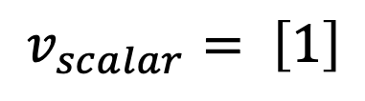
Dimensionality of vectors and matrices
The size of a matrix is defined by its dimensions
The dimensions of a matrix are r × c, sometimes denoted (r,c)
r is the number of rows
c is the number of columns.
If a vector has n elements, a row vector would have the dimensions 1 × n, and a column vector would have the dimensions n × 1.
$$v_{column}= \left[\begin{matrix}1 \\ 2 \\ 3\end{matrix}\right]$$
$$matrix= \left[\begin{matrix}1 & 2 & 3 \\ 4 & 5 & 6 \\ 7 & 8 & 9\end{matrix}\right]$$
$$v_{scalar}= \left[1\right]$$
$$v_{row}= \left[\begin{matrix}1 & 2 & 3\end{matrix}\right]$$
1x1
1x3
3x1
3x3

Slide 8
Creating defined vectors and matrices
[ ] | Defines the enclosed numbers as a matrix
, | Delineates the columns of a matrix (space can also be used)
; | Delineates the rows of a matrix (enter can also be used)
A:B | Creates a vector of uniformly spaced integers from A to B
linspace(A,B,n) | Defines a linearly spaced row vector from A to B with n elements. Default is n=100.
‘ | Transpose
zeros(r,c) | Generates matrix of all zeros with r rows and c columns
ones(r,c) | Generates matrix of all ones with r rows and c columns
rand(r,c) | Generates matrix of random numbers uniformly distributed with r rows and c columns
randi([min max],r,c) | Generates matrix of random integers uniformly distributed with r rows and c columns

Slide 9
Defining matrices in MATLAB
Brackets are used to designate a matrix
mat = [2] → size = 1x1
Commas and spaces are interchangeable and are used to define columns of a matrix
mat = [1,2,3] = [1 2 3] → size = 1x3
Semicolons and enters are used to separate rows in a matrix
mat = [1;2;3] = [1 → size = 3x1
2
3]

Slide 10
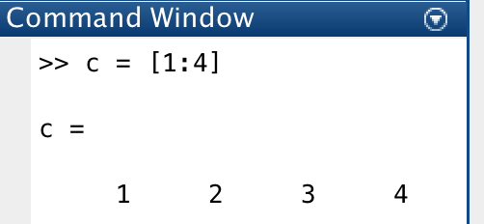
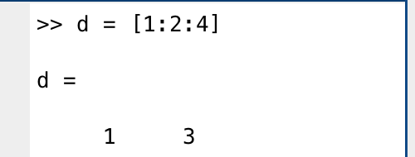
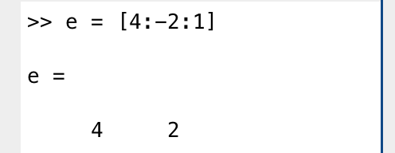
The colon operator
M=[A:B ] Defines the range between two integers with increments of 1
M=[A:n:B] Defines the range between two integers with increments of n
M=[B:-n:A] Defines the range between two integers with decrements of n
**NOTE: n does not have to be an integer!

Slide 11
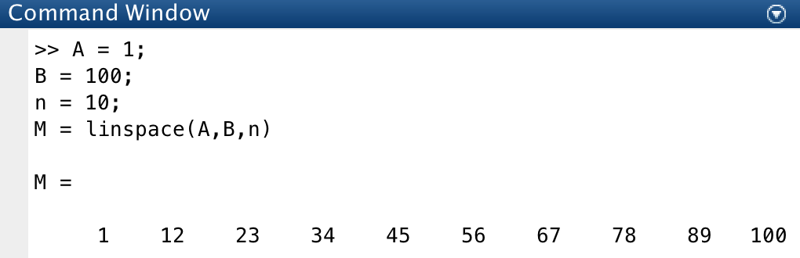
Using linspace
M = linspace(A,B,n) Defines a linearly spaced row vector from A to B with n elements
**Default length is 100 if not given

Slide 12
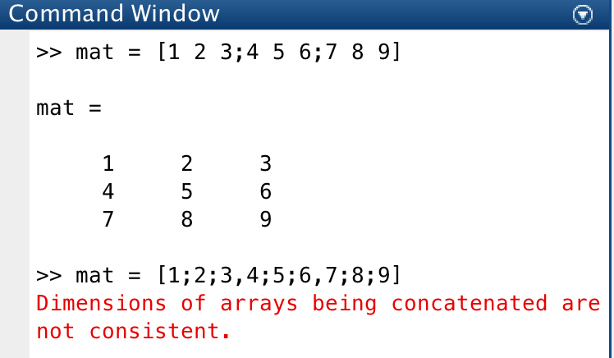
Defining matrices in MATLAB
To define a matrix manually, numbers must be entered row by row (not column by column)

Slide 13
Creating defined matrices (lecture2_liveEx1.m)
Define a row matrix using 4 methods
Define a column matrix using 2 methods
Define a matrix of any size
Define a random matrix
Define a matrix of all zeros

Slide 14
Matrix arithmetic
Addition (+) and subtraction (-) operators can be used as in scalars (see previous week). All math functions work on matrices too (eg log(x), exp(X), etc.)
Matrix multiplication and division require the elemental operator <.>:
* | Scalar and matrix multiplication operator
.* | Element-wise multiplication operator
^ | Scalar and matrix exponentiation operator
.^ | Element-wise exponentiation operator
/ | Right-division operator
./ | Element-wise right-division operator
Light gray rows we don’t need !

Slide 15
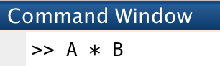
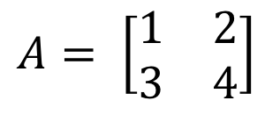
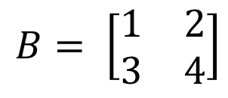
Matrix multiplication
$$A= \left[\begin{matrix}1 & 2 \\ 3 & 4\end{matrix}\right]$$
$$B= \left[\begin{matrix}1 & 2 \\ 3 & 4\end{matrix}\right]$$
2 x 2
2 x 2
Can we multiply these matrices together?
✓
What will the size of the resulting matrix be?
2 x 2
Matrix multiplication:
$$A × B= \left[\begin{matrix}(1∙1)+(2∙3) & \left(2∙2\right)+\left(2∙4\right) \\ \left(3∙1\right)+\left(4∙3\right) & \left(3∙2\right)+\left(4∙4\right)\end{matrix}\right]=\left[\begin{matrix}7 & 10 \\ 15 & 22\end{matrix}\right]$$

Slide 16
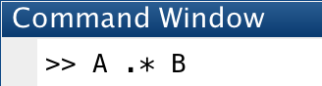
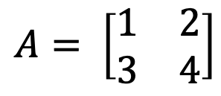

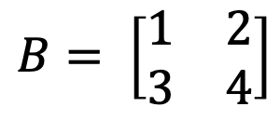
Elemental matrix multiplication
$$A= \left[\begin{matrix}1 & 2 \\ 3 & 4\end{matrix}\right]$$
$$B= \left[\begin{matrix}1 & 2 \\ 3 & 4\end{matrix}\right]$$
2 x 2
2 x 2
Elemental multiplication:
$$A∙B= \left[\begin{matrix}1∙1 & 2∙2 \\ 3∙3 & 4∙4\end{matrix}\right]=\left[\begin{matrix}1 & 4 \\ 9 & 16\end{matrix}\right]$$

Slide 17
Matrix arithmetic (lecture2_liveEx2.m)
Add two matrices
Subtract two matrices
Multiply two matrices
Square root of a matrix

Slide 18
Matrix dimensionality using functions
length(M) | length
[r c] = size(M) or x = size(M,dim) | r = row #; c = column # dim=1 for rows and 2 for columns

Slide 19
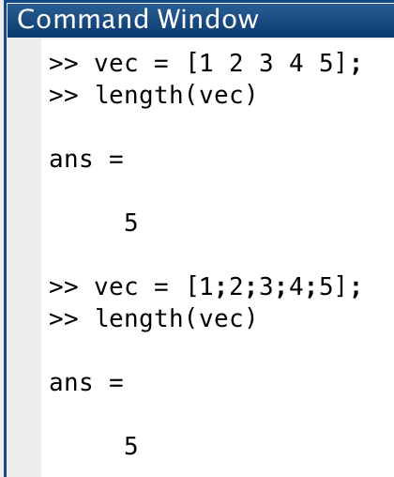
Finding the size of a vector
To determine the size of a vector, we can use the function length

Slide 20
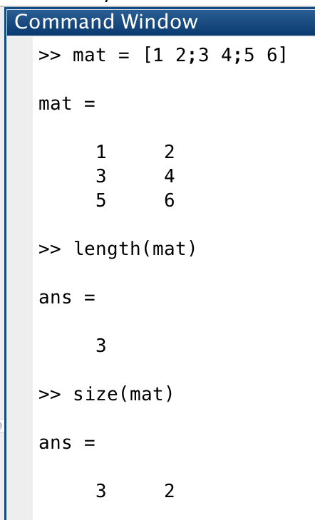
Finding the size of a matrix
To determine the size of a matrix:
The length will only give us the length of the maximum row or column
Instead, we can use the function size

Slide 21
MATLAB dimension convention
Functions that operate on matrices are often performed along a single dimension. Ex:
What is the fastest heart rate for each exercise group?
What is the average heart rate per exercise group?
Which student had the lowest average heart rate overall?
1st
1st
2nd
cols = dimension 2
HEART RATE DURING EXERCISE
Student | Heart rate (bpm)
 | 1 min of exercise | 2 min of exercise | 3 min of exercise | 4 min of exercise | 5 min of exercise
1 | 88 | 98 | 102 | 110 | 110
2 | 92 | 96 | 103 | 115 | 118
3 | 87 | 100 | 112 | 112 | 130
4 | 93 | 109 | 115 | 120 | 122
rows = dimension 1
If we had multiple trials, there could be a dimension 3

Slide 22
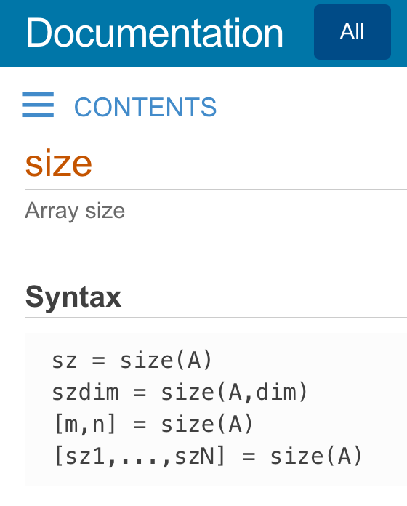
Specifying dimensionality when calling a function
Documentation for certain functions might say you can specify the dimension:

Slide 23
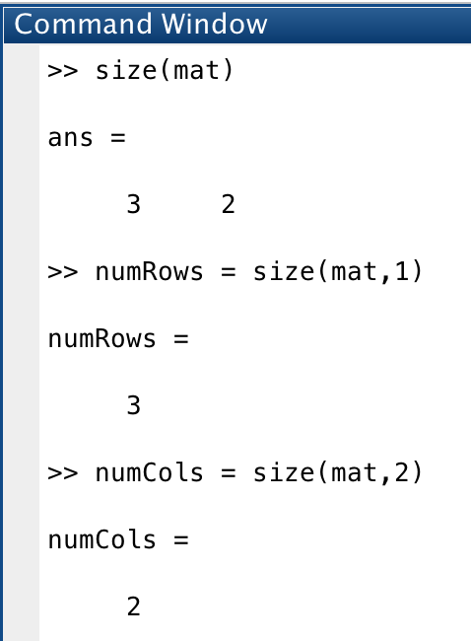
Specifying dimensionality when calling a function
To define the dimension, use 1 for rows and 2 for columns (see slide 19)

Slide 24
Length, size, and dimensionality (lecture2_liveEx3.m)
Determine the length and size of a column vector
Determine the length and size of a row vector
Determine the size of a 4x2 matrix of all ones

Slide 25
Matrix concatenation and manipulation
‘ | Matrix transposition
[mat1,mat2] | Concatenate horizontally (extend # columns)
[mat1;mat2] | Concatenate vertically (extend # rows)

Slide 26
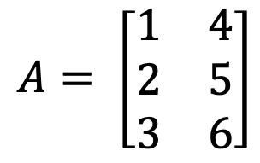
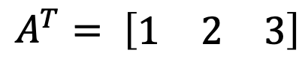
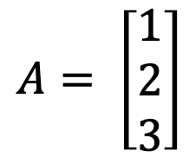
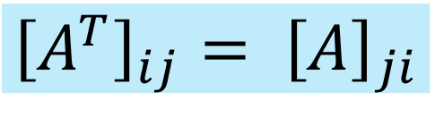
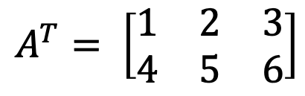
Matrix transposition
Transposing a matrix is an operation that flips a matrix over its diagonal:
(r,c) → (c,r)
$${\left[A^{T}\right]}_{ij}= {\left[A\right]}_{ji}$$
$$A= \left[\begin{matrix}1 \\ 2 \\ 3\end{matrix}\right]$$
Ex 1:
$$A^{T}= \left[\begin{matrix}1 & 2 & 3\end{matrix}\right]$$
$$A= \left[\begin{matrix}1 & 4 \\ 2 & 5 \\ 3 & 6\end{matrix}\right]$$
$$A^{T}= \left[\begin{matrix}1 & 2 & 3 \\ 4 & 5 & 6\end{matrix}\right]$$
Ex 2:

Slide 27
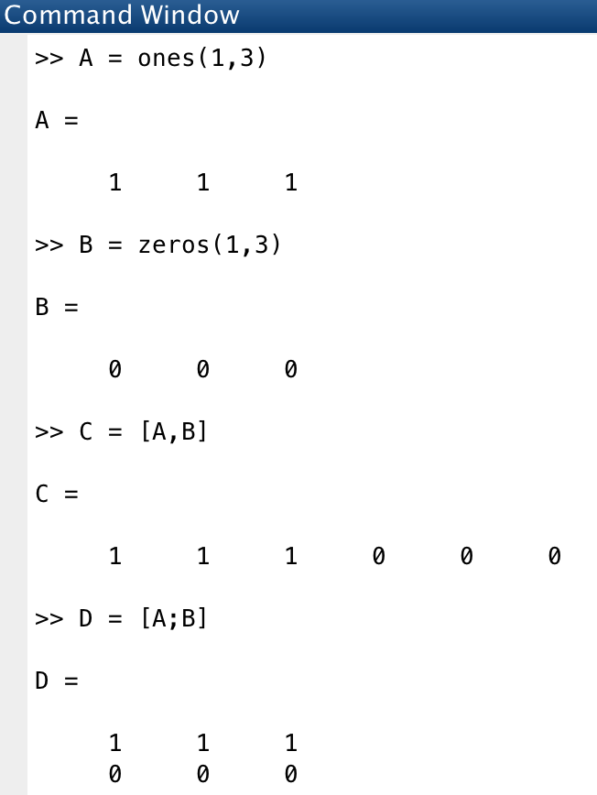
Matrix concatenation
Matrix concatenation: joining matrices together to make larger matrices
Matrices do not have to be the same size to concatenate (only the dimensionality has to match)!!!

Slide 28
Vertical concatenation
Extending a matrix in the vertical direction
Only the number of columns has to be equal (stacking layers of a cake on top of each other….doesn’t matter the height of each layer!)
Since we are extending the number of rows, the dimension is 1

Slide 29
Horizontal concatenation
Extending matrices in the horizontal direction
Only the number of rows has to be equal (lining books in a book shelf….they can have any width as long as they are of the same height!!)
Since we are extending the number of columns, the dimension is 2

Slide 30
Use lecture2_grpEx1_template.m and complete the following:
Generate a column vector of size 5x1 using both linspace and the transposition function. The values of the vector are up to you.
Concatenate the following matrices both horizontally and vertically
Concatenate the following matrices using the correct method
Group exercise 1

Slide 31
Working with .mat files
load | Load in files to work with
save | Save data in stored variables
who | List all variables in the workspace

Slide 32
Working with .mat files
.mat files are particularly useful to save variables in your workspace
Use load and save to save and load .mat files
You can save as many variables as you want in the same .mat file
.mat files can be overwritten by saving variables to the same name

Slide 33
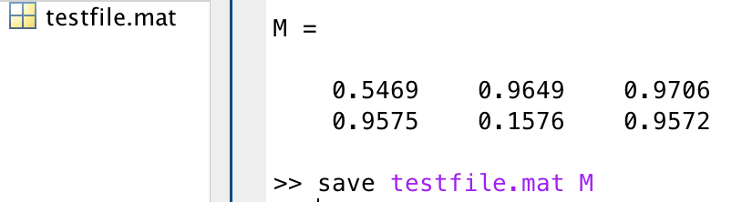
save .mat files
Syntax:
save InputFileName.mat <list names of variables>
-You can save more than one variable at once separated by a space

Slide 34
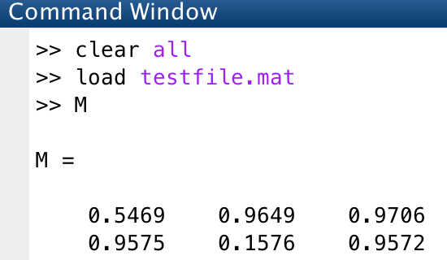
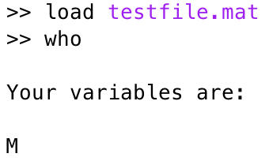
load .mat files
Syntax:
load <FileName.mat>
Use who if you forget the saved variable names
You can also double click on it to populate the workspace!

Slide 35
Cell arrays and .mat files (lecture2_liveEx4.m)
load AcceptanceRates.mat
Update data
Save AcceptanceRates2.mat with year2 and acceptance2
Update AcceptanceRates.mat with the new variables

